Slide 1
Enhancing Customer Experience: Leveraging Predictive Analytics for Payment Channel Optimization
By: Devin Duran and Russ Steil

Slide 2
Overview
We analyze a dataset containing customers for an insurance company who have a bill due in the next five days
We create a predictive model for this insurance company to see how likely a customer is to make a service payment call in the next five days
The predictive model we will use is random forests, and we will perform data wrangling and frequently adjust the hyperparameters of the model

Slide 3
Workflow
Undersample and Oversample
Train Logistic Regression Model, Undersampled RF, Oversampled RF, and Imbalanced RF
Find Feature Importances
Clean Data

Slide 4
Data Import and Cleansing
We import the packages we need load in our dataset containing 130,086 observations and 29 features
Our target variable is ‘Call_Flag’ which contains values of 0 or 1, representing if a customer made a service payment call or not
We drop redundant features and take care of missing values
We remove ‘EVENT1_30_FLAG’ because all of the values are zero
We remove ‘DATE_FOR’ since there are only five dates that don’t really seem to match

Slide 5
Data Imbalance
When cleansing the data, we print the value counts of the ‘Call_Flag’ feature only to notice massive imbalance between the two classes
Of the 130,086 customers, 125,322 do not make a service payment call while only 4764 customers make a service payment call
We can combat this using techniques of undersampling and oversampling

Slide 6
Random Undersampling
One way to fix the problem of class imbalance is by undersampling which involves removing observations from the majority class until the two are balanced out
We use LabelEncoder on the categorical features
Maps categorical variables to integers
We use Random Undersampling as our technique
Another technique is TOMEK which removes instances from the majority class in pairs of close instances of opposite classes
We don’t use this due to the high dimensionality of our data
For continuous variables we normalize the data using StandardScaler
We drop any features that are still categorical after resampling

Slide 7
Oversampling
Another balancing technique is oversampling which is adding observations to the minority class
A type of oversampling that we can use is SMOTE
Generates data for the minority class by picking a point from the minority class and running KNN on it
We run OneHotEncoder on our categorical features and once again use StandardScaler on our continuous features
OneHotEncoder - Takes these features and converts them into numerical format via multiple new columns
Oversampling is very prone to overfitting however, especially with the amount of class imbalance present in this data
Because of this, we do not run it with different feature importance thresholds

Slide 8
Random Forests
We run random forests with the scaled continuous features, encoded categorical features, and no temporal features
We take the accuracy, precision, recall, and F1 score for the model
We also will create a visualization that illustrates the importance for each of the data’s features
We do this for both undersampled and oversampled data, as well as the original data and the model addressed for class imbalance

Slide 9
Finding Feature Importances
We run a decision tree model on training data (split at 75%) with 100 estimators
Then, we use a feature importance threshold of 0.05 to determine top features

Slide 10
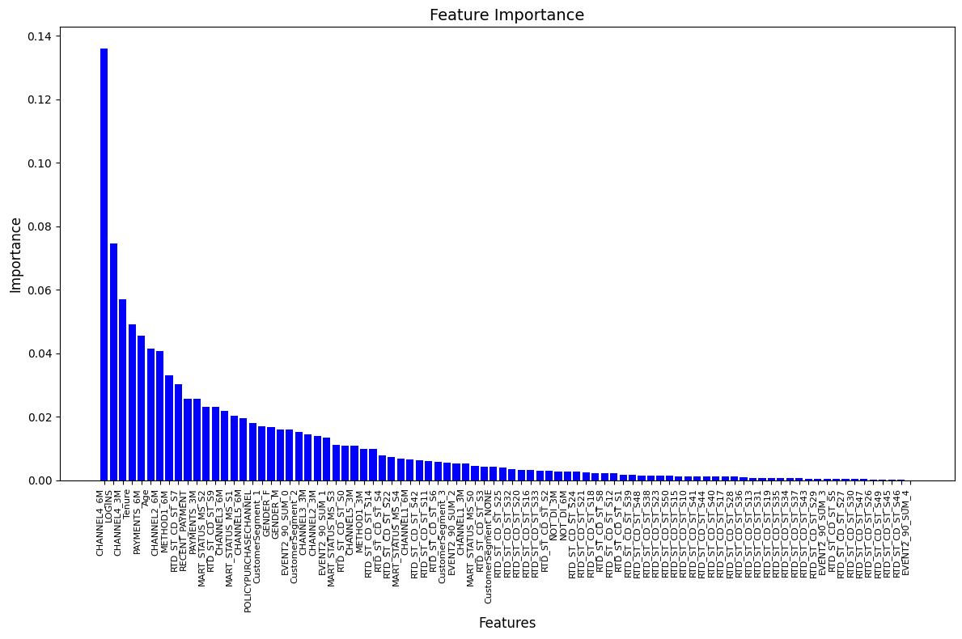

Slide 11
Important Features
We now train the model with data where we only keep the most important features
We select those with an importance of above 0.05 which are 'Tenure', 'Age', 'CHANNEL4_6M', 'PAYMENTS_6M', 'CHANNEL4_3M', and 'LOGINS'
In addition, we also run a logistic regression with these features as well

Slide 12
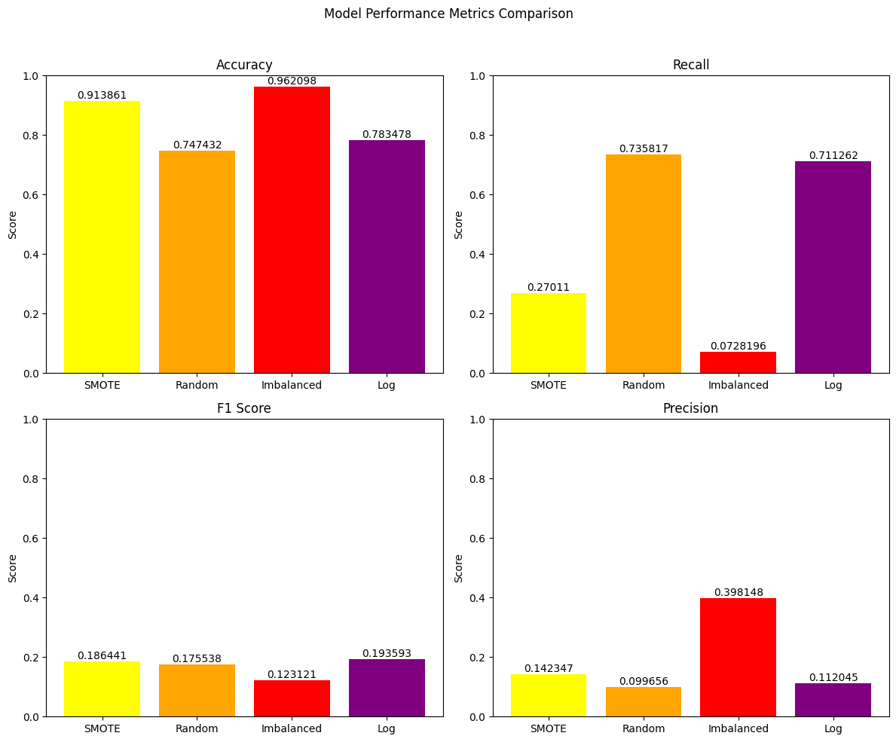
Perfo

Slide 13
Conclusion
Need more service call data
In this analysis, there was a lot of experimentation done with the classes and feature importances
For the most part, setting thresholds for feature importance leads to a minimal change in the model’s metrics, suggesting that every feature appears to contribute to the likelihood of a customer making a service call
Many of the models however were prone to evaluation bias and overfitting
Metrics had very high accuracies, but very low F1-scores, brought down by either a bad precision or bad recall
Most likely due to high dimensionality; models with only the important features did not have this problem
Since, our priority to is to maximize recall, our analysis shows that the random forests with undersampling and logistic regression are the best models for this situation

